Slide 1

GPT-2 Text Generator: Unleashing AI Creativity
Explore the power of GPT-2 for advanced text generation. This presentation delves into implementing and utilizing a pre-trained GPT-2 model for creative and practical applications.

Slide 2

Setting Up the Environment
1
Install Dependencies
Begin by installing the Transformers library using pip. This provides access to GPT-2 models.
2
Import Libraries
Import necessary modules from Transformers. This includes the model and tokenizer classes.
3
Load Pre-trained Model
Initialize the GPT-2 model and tokenizer using the from_pretrained method.

Slide 3

Understanding the GPT-2 Architecture
Transformer-based
GPT-2 utilizes the Transformer architecture, enabling efficient processing of sequential data.
Attention Mechanism
The model employs self-attention to capture context and relationships within the input text.
Large-scale Pre-training
GPT-2 is pre-trained on diverse internet text, giving it broad language understanding.

Slide 4
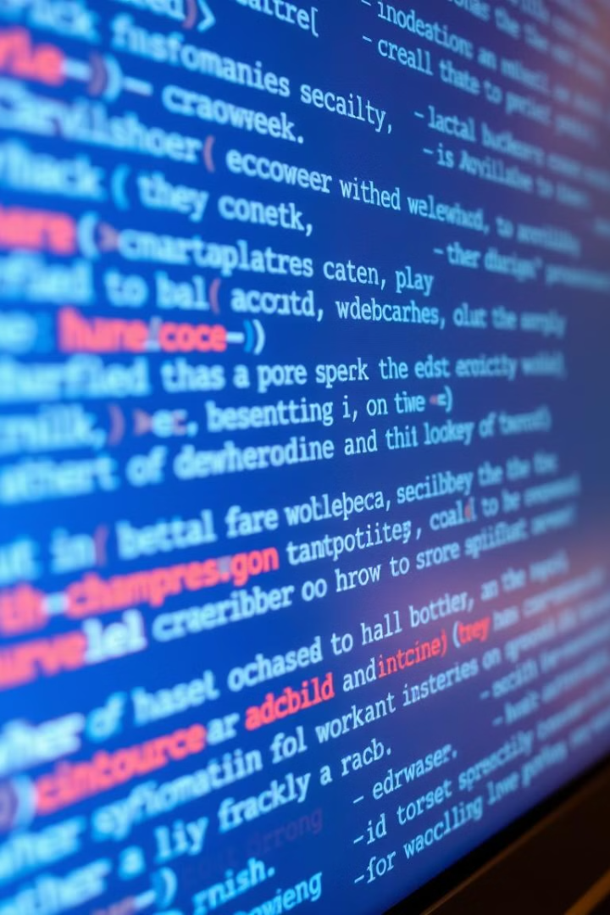



Tokenization Process
Input Text
The raw text prompt is provided as input to the tokenizer.
Tokenization
The tokenizer splits the text into individual tokens, including words and subwords.
Encoding
Tokens are converted to numerical IDs for model processing.

Slide 5
Text Generation Function
Input Processing
Model Generation
Output Decoding
The function takes a prompt and encodes it using the tokenizer.
It uses the generate method with specified parameters for text generation.
The generated token IDs are decoded back into human-readable text.

Slide 6

Generation Parameters
Parameter
Value
Purpose
max_length
300
Limits output length
temperature
0.5
Controls randomness
top_k
50
Limits vocabulary choices
repetition_penalty
1.2
Reduces repetition

Slide 7
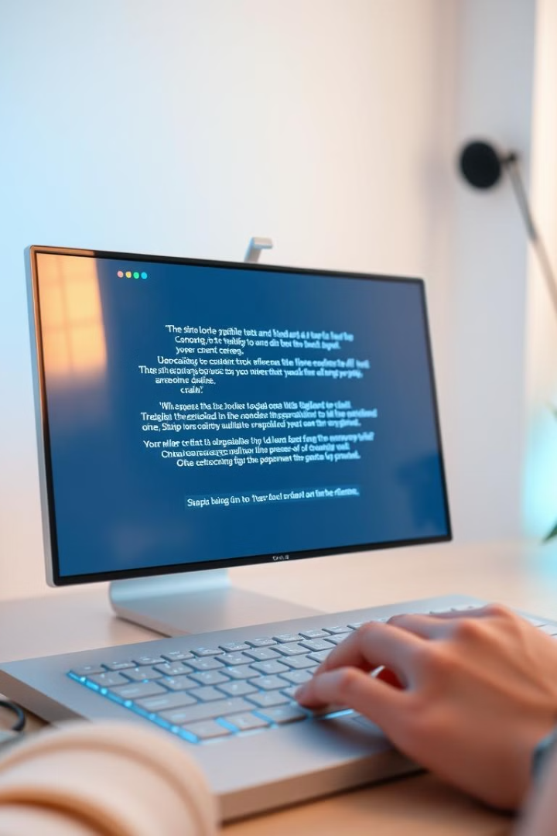



User Interaction
Input Prompt
Users enter their desired text prompt through the console input.
Processing
The prompt is passed to the text generation function for AI processing.
Output Display
The generated text is printed to the console for the user to read.

Slide 8
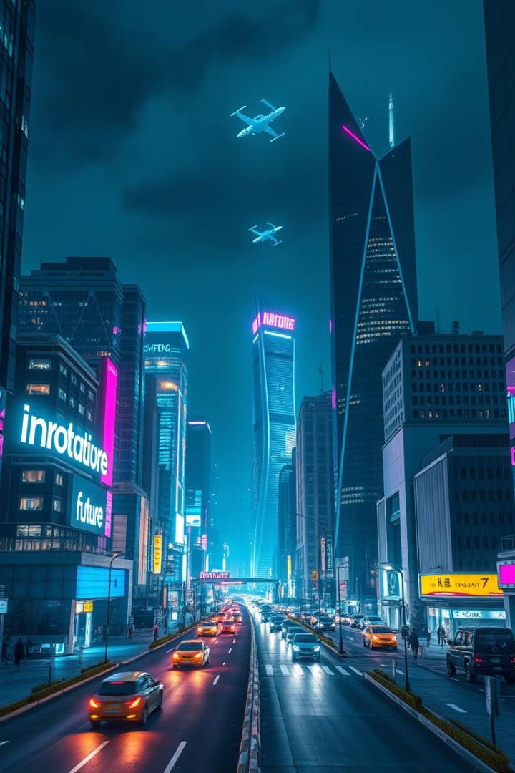
Applications and Future Developments
1
Creative Writing
GPT-2 can assist in generating story ideas, poetry, and dialogue.
2
Content Generation
The model can help create blog posts, product descriptions, and marketing copy.
3
Language Translation
Future developments may enhance GPT-2's capabilities in cross-lingual text generation.
4
Customization
Fine-tuning the model on specific datasets can tailor it for specialized applications.

